Slide 1
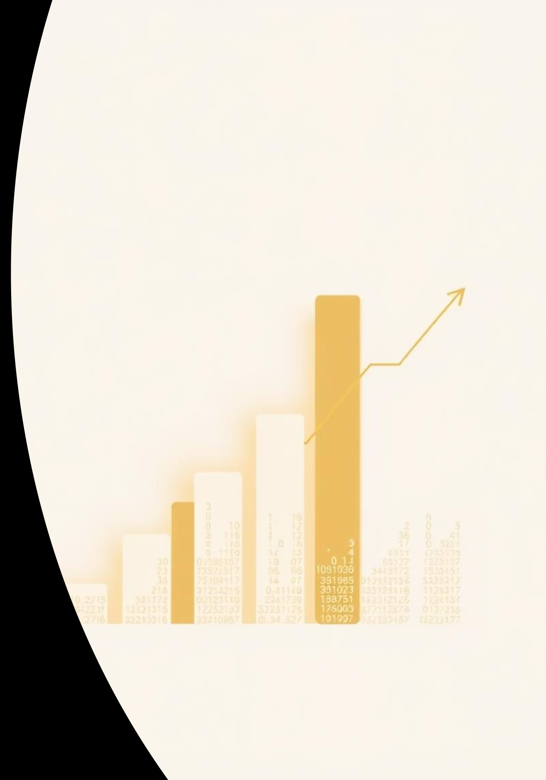

FRE 7251 Course Project
This report details a technical trading strategy for TQQQ, a leveraged NASDAQ-100 ETF, using historical data and bootstrap simulations.
by Charlie Yi

Slide 2

Project Overview
1
Strategy & Parameters
Design and rationale for moving average parameters.
2
Historical Performance
Evaluation of strategy on past TQQQ data.
3
Bootstrap Implementation
AR(1) model for simulating price paths.
4
Performance Analysis
Profit/loss distribution and statistical testing.

Slide 3
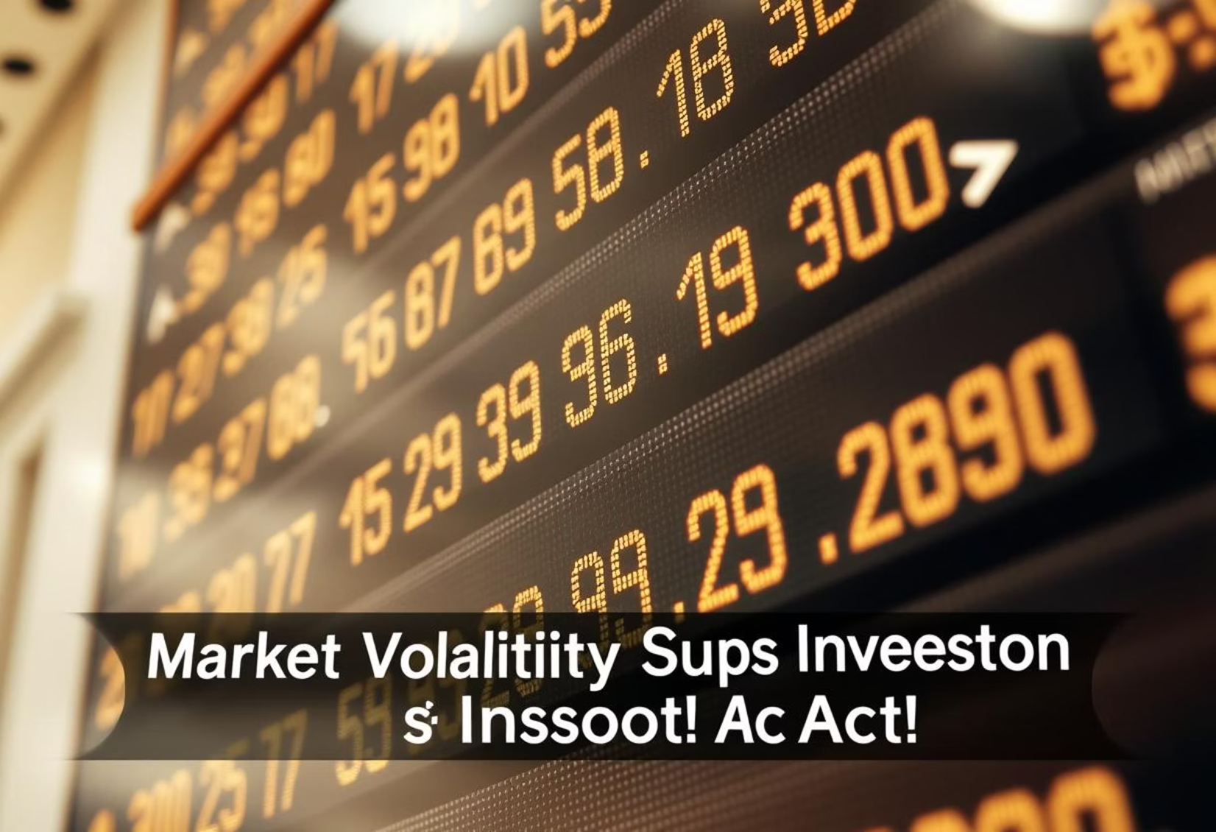
Trading Strategy: Moving Average Crossover
Entry Signal
Rationale
Buy when 20-day MA crosses above 50-day MA.
Captures trends in volatile TQQQ, reducing noise from short-term fluctuations.
Exit Signal
Sell when 20-day MA crosses below 50-day MA.

Slide 4
Historical Performance (2020-2024)
11
46.22%
492.81%
0.41
Trades
Strategy Return
Buy-and-Hold Return
Strategy Sharpe Ratio
0.88
34.96%
-76.82%
B&H Sharpe Ratio
Winning Trades
Max Drawdown
Strategy underperformed buy-and-hold in absolute return but aimed for risk control.

Slide 5

Bootstrap Simulation: AR(1) Model
Modeling Returns
Simulation & Application
100 synthetic return series generated, converted to price paths, and strategy applied.
Parameters estimated from historical TQQQ returns.
Assumptions
AR(1) model captures autocorrelation; residuals are normally distributed.

Slide 6
Bootstrap Performance (Average of 100 Simulations)
12.22
565.09%
1973.12%
0.78
Avg. Trades
Avg. Strategy Return
Avg. B&H Return
Avg. Strategy Sharpe
1.01
31.72%
-57.37%
Avg. B&H Sharpe
Avg. Win %
Avg. Max Drawdown
Strategy shows positive average returns with a wide range of outcomes and right-skewed distribution.

Slide 7
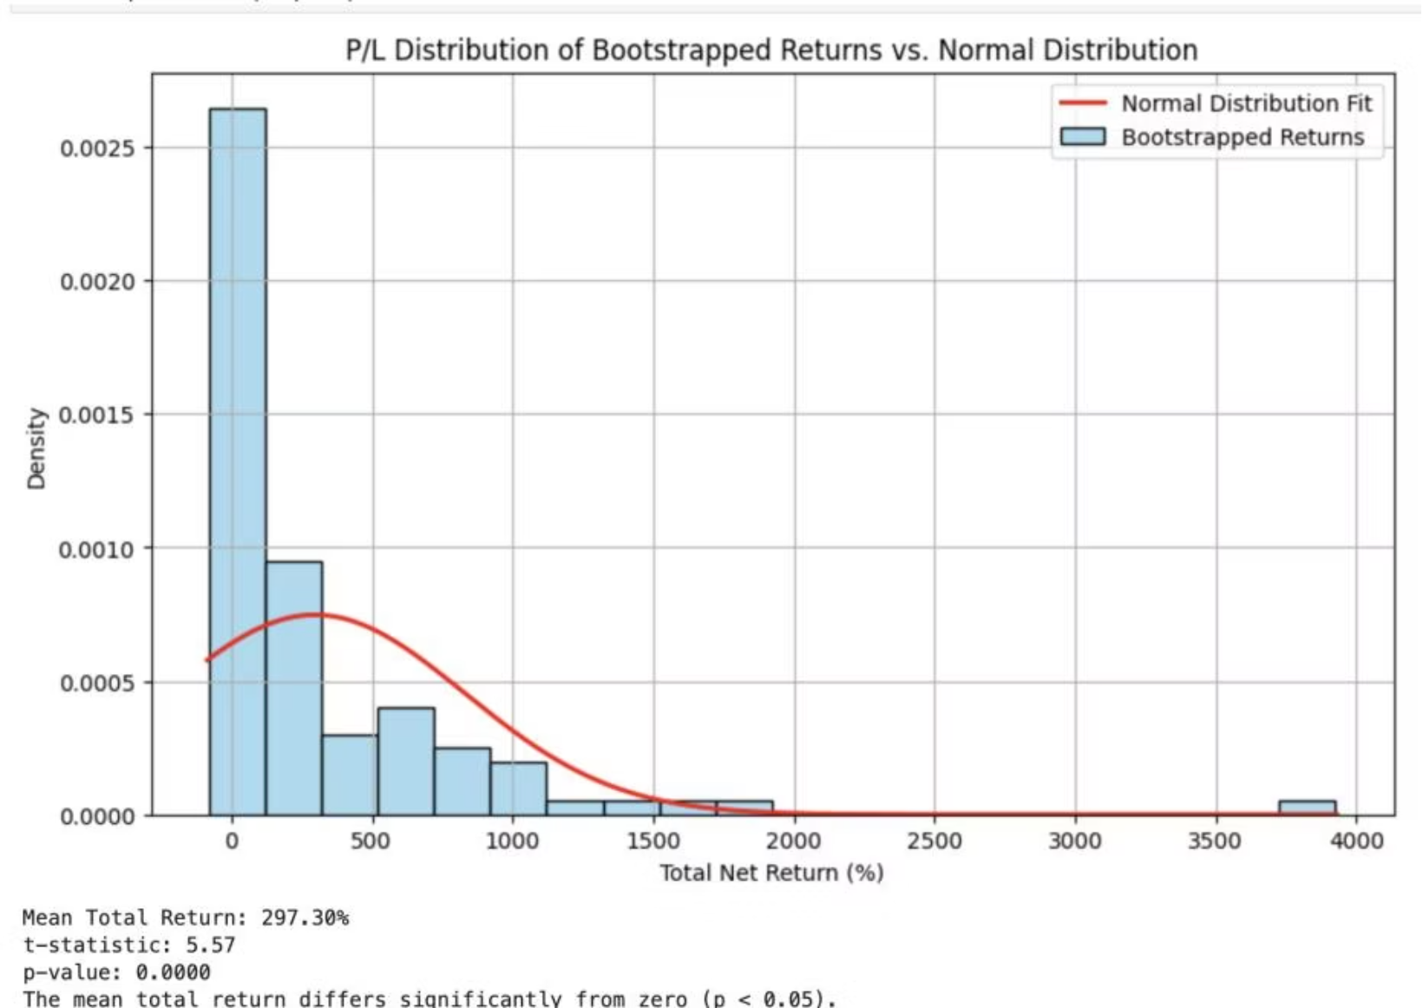
Profit/Loss Distribution Analysis
Histogram Plot
Bootstrapped returns are right-skewed with heavier tails, not well-fit by normal distribution.
Statistical Testing
T-test (t-stat ~5.57, p-value < 0.0001) confirms statistically significant positive mean total return.

Slide 8
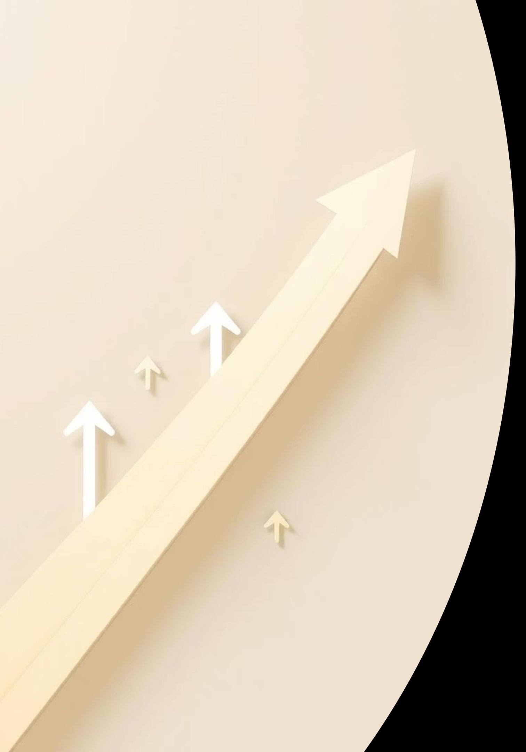
Conclusion & Future Work
Strategy Viability
Risk Management
Moderately positive historical performance; bootstrap suggests higher average returns with similar risk.
Right-skewed P/L with fat tails indicates potential for gains but also significant drawdowns.
Future Enhancements
Explore alternative MA windows, add indicators, or implement dynamic risk controls.

